Slide 1

Slide 1
ADDRESSING NIGERIA'S NATIONAL
GRID COLLAPSE ISSUES —
AN ELECTRICAL ENGINEERING APPROACH

Slide 2
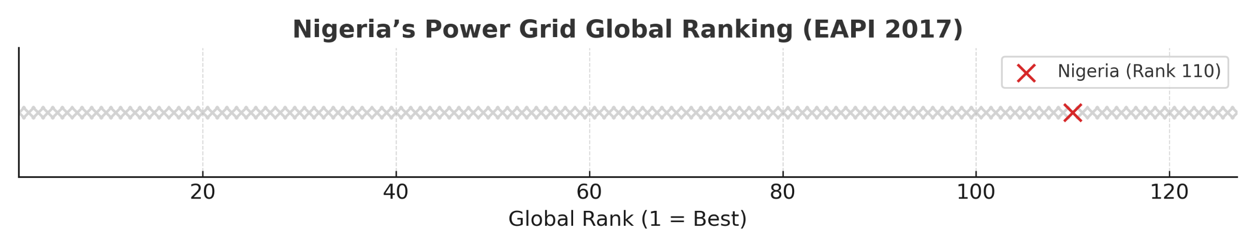
Slide 2
INTRODUCTION
Nigeria’s power grid is among the most unstable globally, ranking 110th out of 127 countries on the 2017 Energy Architecture Performance Index. In 2024 alone, the grid collapsed at least twelve times.
To address this, the study proposes a modernized smart-grid framework combined with real-time monitoring, MATLAB-based fault simulations, and economic feasibility analysis tailored to Nigeria’s power sector.
DEPARTMENT OF ELECTRICAL/ELECTRONICS ENGINEERING
2

Slide 3
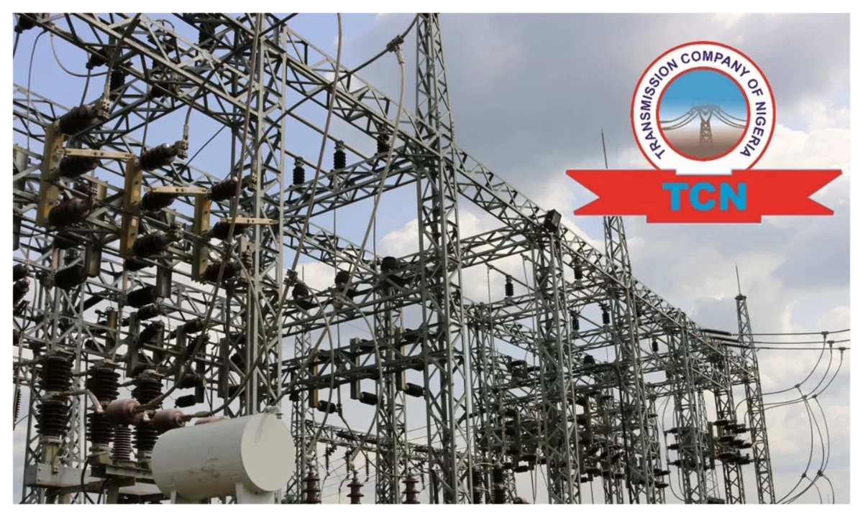
PROBLEM STATEMENT
The Nigerian power grid is both structurally and operationally fragile. Only about one-third of installed generation capacity is effectively utilized, limiting supply. The grid’s centralized architecture means that a single failure can cascade into a nationwide blackout. Without intervention, this cycle of collapse and costly recovery will continue to undermine national development.
Note. Sourced from Daily Post Nigeria (2025)
DEPARTMENT OF ELECTRICAL/ELECTRONICS ENGINEERING

Slide 4
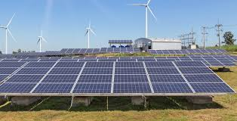
RESEARCH OBJECTIVES
This project aims to stabilize Nigeria’s grid by combining real-time monitoring, automation, and renewables. Key objectives include:
Predictive Maintenance
Renewable Microgrids
Transformer Health Monitoring
IoT Edge Processing
Economic Analysis
Note. Sourced from trystar.com (2024)
DEPARTMENT OF ELECTRICAL/ELECTRONICS ENGINEERING

Slide 5

SIGNIFICANCE OF STUDY
Note. Sourced from ukm.my (2025)
This study addresses one of Nigeria’s most persistent infrastructure challenges through an electrical engineering lens, promising a shift from a reactive to a proactive maintenance culture.
The study also contributes to the UN’s Sustainable Development Goal 7, ensuring access to affordable, reliable, and sustainable energy for all.
DEPARTMENT OF ELECTRICAL/ELECTRONICS ENGINEERING

Slide 6
LITERATURE REVIEW
Global case studies demonstrate the transformative potential of smart-grid, FLISR, and predictive maintenance technologies.
This literature, however, reveals a critical gap: while predictive maintenance, FLISR, and microgrids have each been explored individually, few studies integrate all three into a cohesive engineering and economic strategy tailored to Nigeria’s unique grid challenges.
DEPARTMENT OF ELECTRICAL/ELECTRONICS ENGINEERING

Slide 7
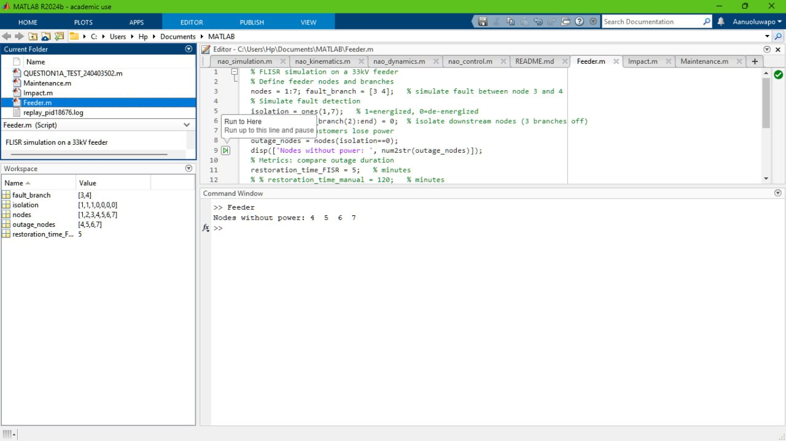
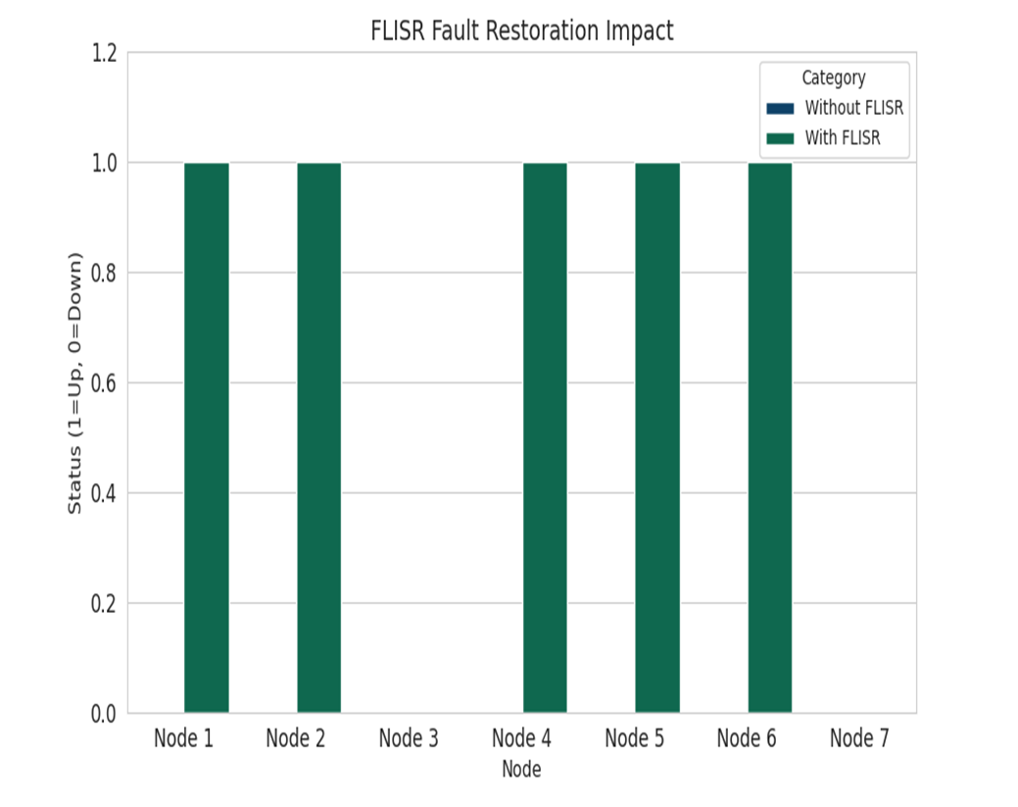
METHODOLOGY
I began with data collection from the Transmission Company of Nigeria outage logs and distribution company reports to identify systemic weaknesses.
I then modelled a 33 kV radial feeder in MATLAB/Simulink, incorporating FLISR logic to simulate automated fault isolation and restoration.
DEPARTMENT OF ELECTRICAL/ELECTRONICS ENGINEERING

Slide 8
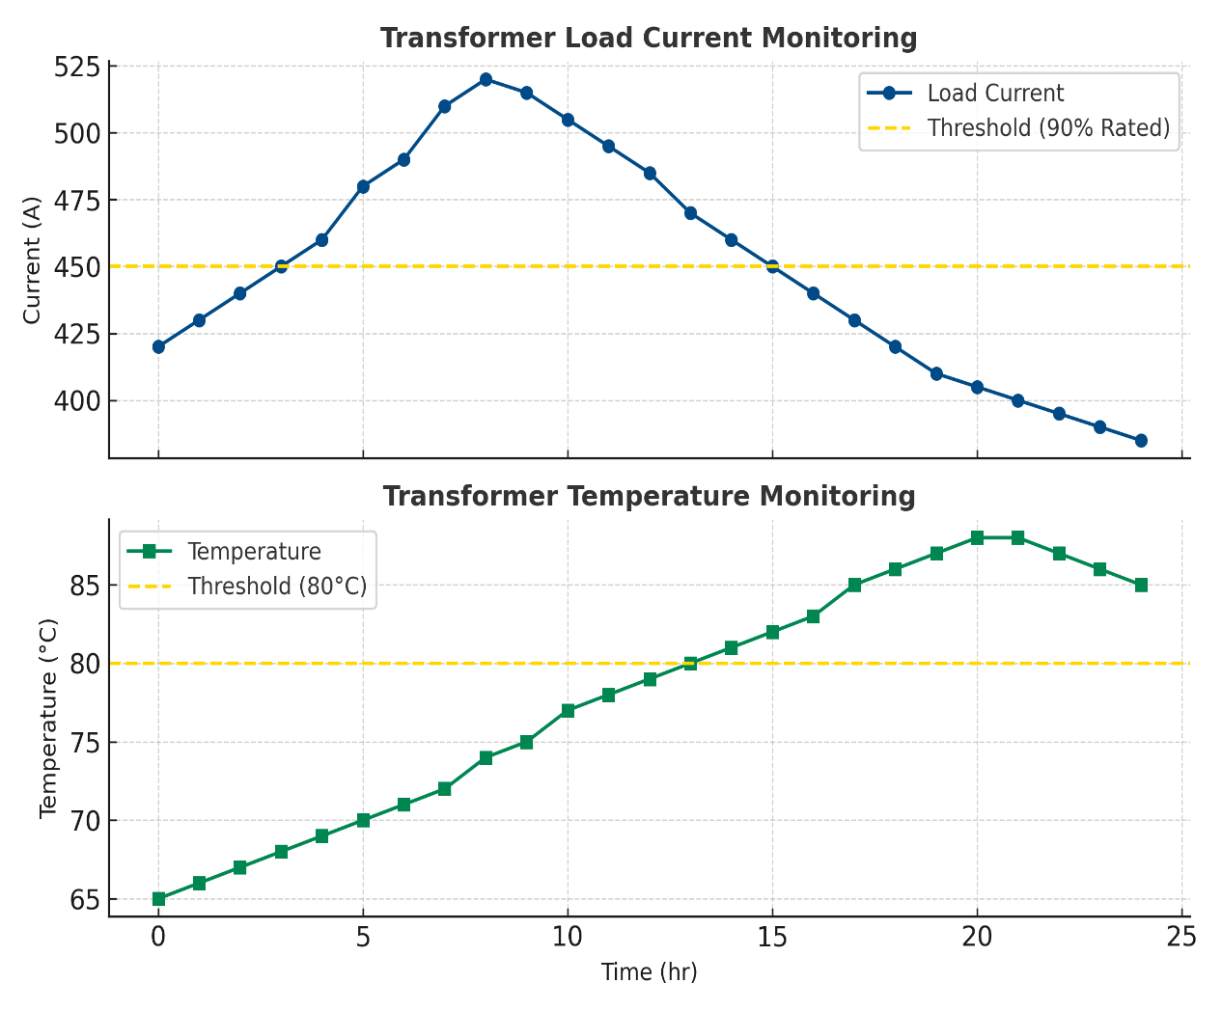
METHODOLOGY (cont’d)
Separately, I developed a predictive maintenance algorithm in MATLAB to monitor transformer load and temperature, generating alerts when values exceeded safe thresholds.
DEPARTMENT OF ELECTRICAL/ELECTRONICS ENGINEERING

Slide 9
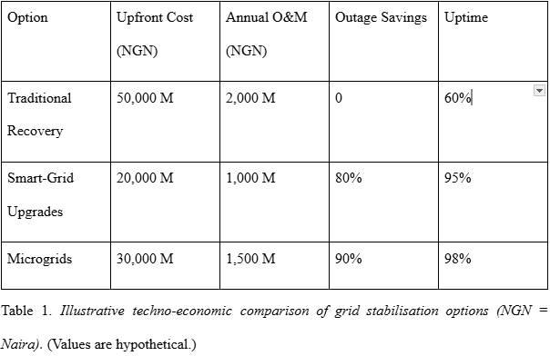
METHODOLOGY (cont’d)
Finally, using a techno-economic analysis, I compared three scenarios: traditional reactive repairs, smart-grid upgrades, and microgrid deployment, factoring in both capital expenditure and outage cost savings.
Illustrative techno-economic comparison of grid stabilization options (NGN = Naira). (Values are hypothetical.)
DEPARTMENT OF ELECTRICAL/ELECTRONICS ENGINEERING

Slide 10
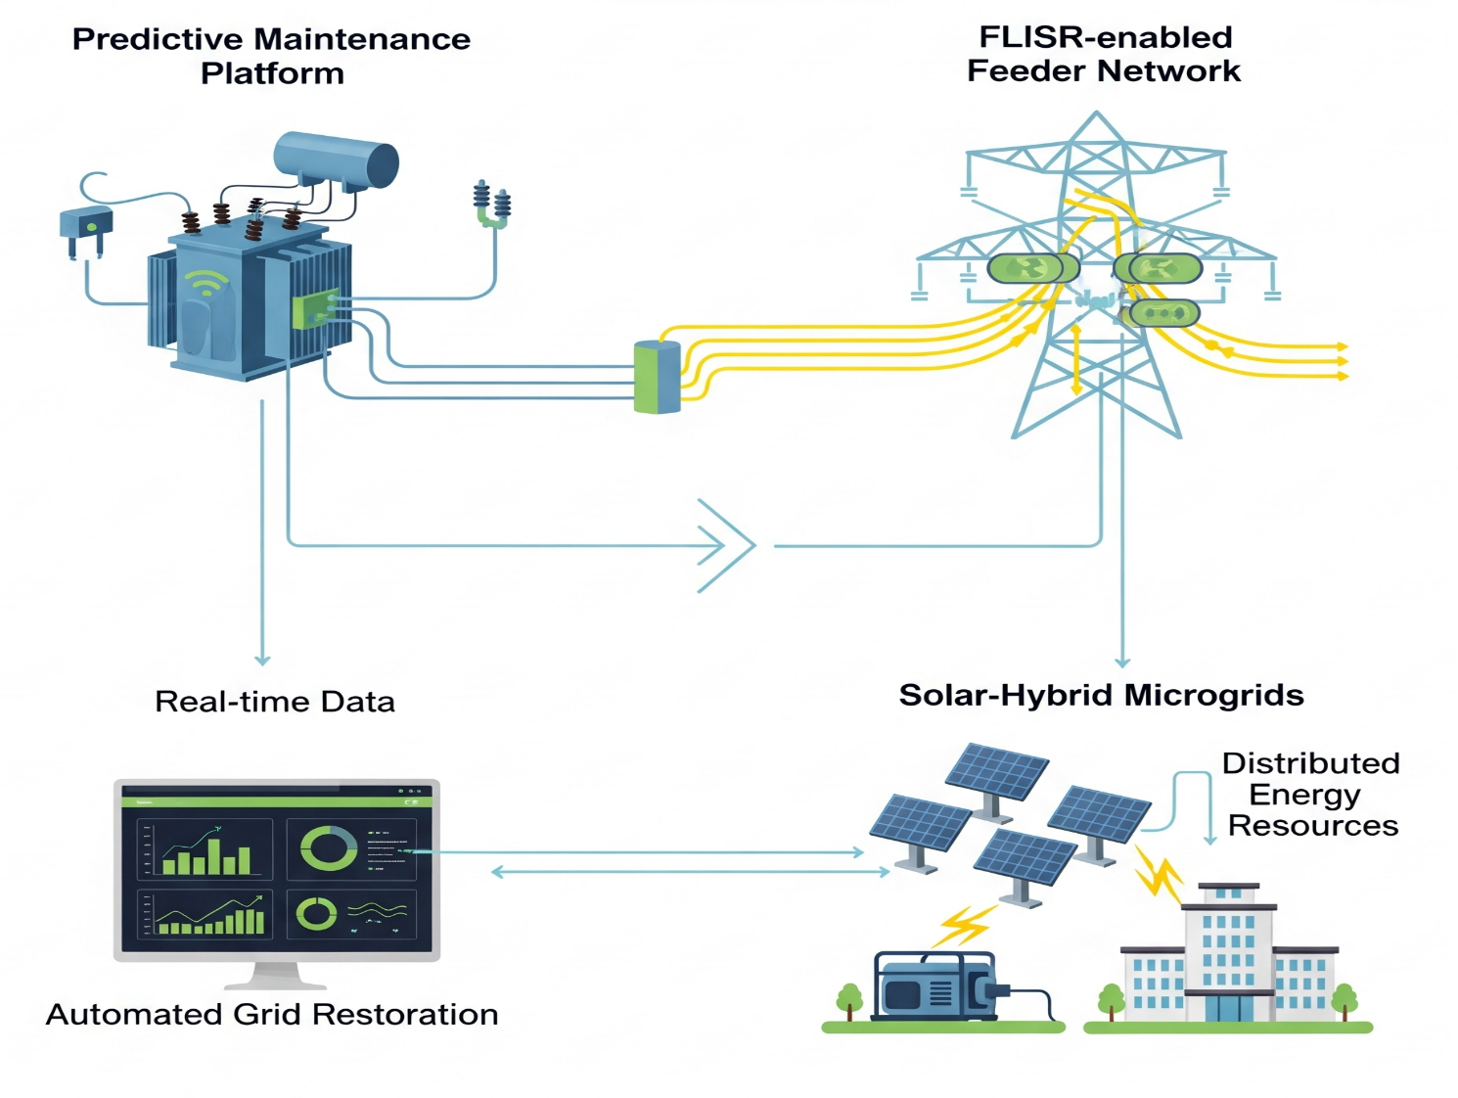
SYSTEM DESIGN
The proposed system comprises three integrated components:
A predictive maintenance platform
A FLISR-enabled feeder network
A network of solar-hybrid microgrids
DEPARTMENT OF ELECTRICAL/ELECTRONICS ENGINEERING

Slide 11
EXPERIMENTAL SETUP
The 33 kV feeder simulation included seven load nodes, each protected by relays and reclosers.
A fault was introduced between Nodes 2 and 3 to test FLISR performance. In the predictive maintenance simulation, 24-hour operational data for a transformer was generated, including hourly current and temperature readings.
Thresholds were set at 90% of rated current and 80°C. Any breach of these thresholds triggered an alert.
Both models were run in MATLAB to assess performance under fault and overload conditions.
DEPARTMENT OF ELECTRICAL/ELECTRONICS ENGINEERING

Slide 12
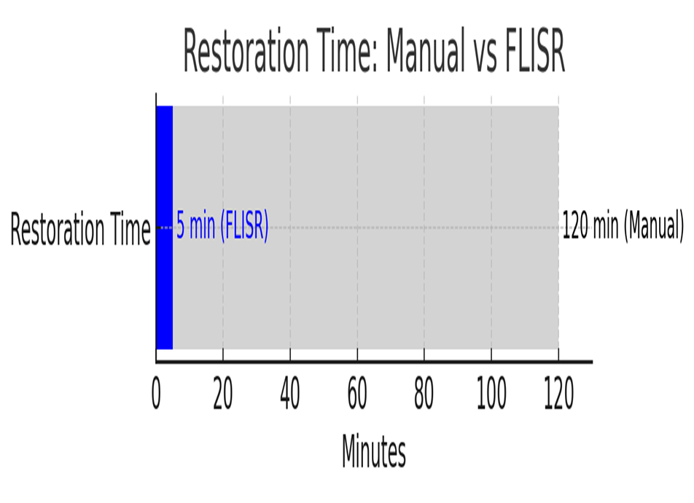
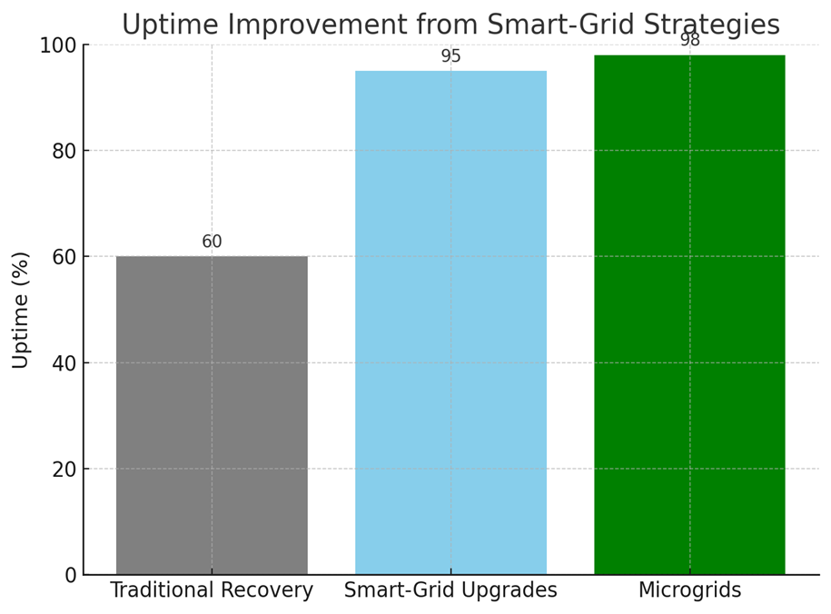
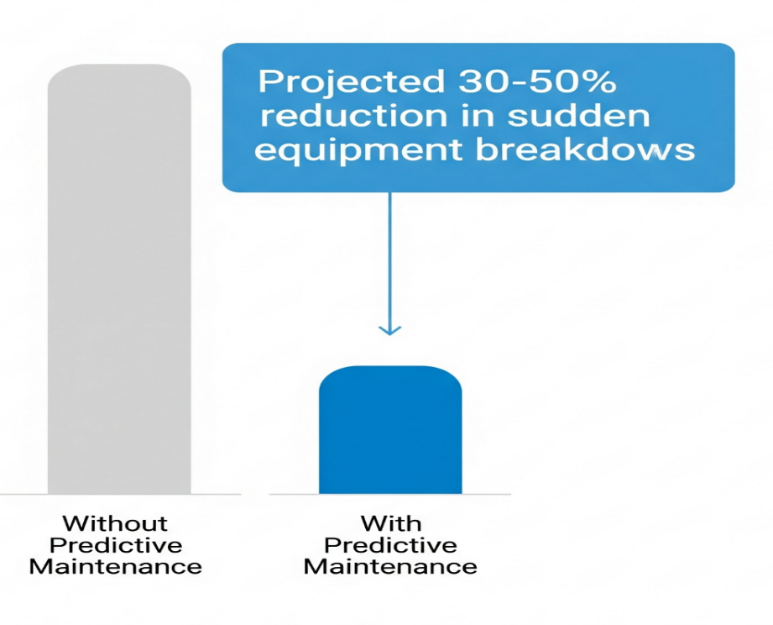
RESULTS
DEPARTMENT OF ELECTRICAL/ELECTRONICS ENGINEERING

Slide 13
CONCLUSION
This research demonstrates that integrating predictive maintenance, FLISR, and microgrids can transform Nigeria’s grid from a fragile, failure-prone system into a resilient, adaptive network. The combined engineering approach offers not only technical feasibility but also economic justification, with potential savings that far outweigh the initial investment. Implementation at scale will require coordinated policy support, workforce training, and targeted pilot projects to build momentum for nationwide adoption.
DEPARTMENT OF ELECTRICAL/ELECTRONICS ENGINEERING

Slide 14
REFERENCES
- Bloomberg New Energy Finance. (2020). Nigeria case study. In State of the Global Mini-Grids Market Report 2020. -
https://minigrids.org/wp-content/uploads/2020/06/Nigeria_Case_Study.pdf
- Karnilius, G. F., Isaac, J. I., & Falama, R. (2024). Smart grid technologies: advancements and applications in Nigeria. Journal of Multidisciplinary Science: MIKAILALSYS, 2(3), 359–370
https://ejournal.yasin-alsys.org/mikailalsys/article/view/3777
- Sachdeva, P., Feb (2020, Feb). Illustration of FLISR Operation. | Download Scientific Diagram
https://www.researchgate.net/figure/llustration-of-FLISR-Operation_fig3_341876589
- Temple, E. (2024, Oct 23). The implications of incessant national grid collapse.
https://www.scirp.org/journal/paperinformation?paperid=46061 Blueprint.
- Yusuf, I. A. (2024, Nov 10). How national grid collapse impacts economy negatively – Report.
https://thenationonlineng.net/how-national-grid-collapse-impacts-economy-negatively-report/ The Nation.
- Zulu, E. (2024, Sep 20). FG fixes H1 2025 for launch of SCADA system to stabilize national power grid.
https://energycentral.com/news/fg-fixes-h1-2025-launch-scada-system-bid-stabilise-national-power-grid This Day.
DEPARTMENT OF ELECTRICAL/ELECTRONICS ENGINEERING

Slide 15

Slide 11
THANK YOU

